Slide 1
West Valley, NY Nuclear Waste Site
Threat to the Great Lakes
Park School
February 27, 2015
Diane D’Arrigo, Nuclear Information & Resource Service
West Valley Action Network

Slide 2
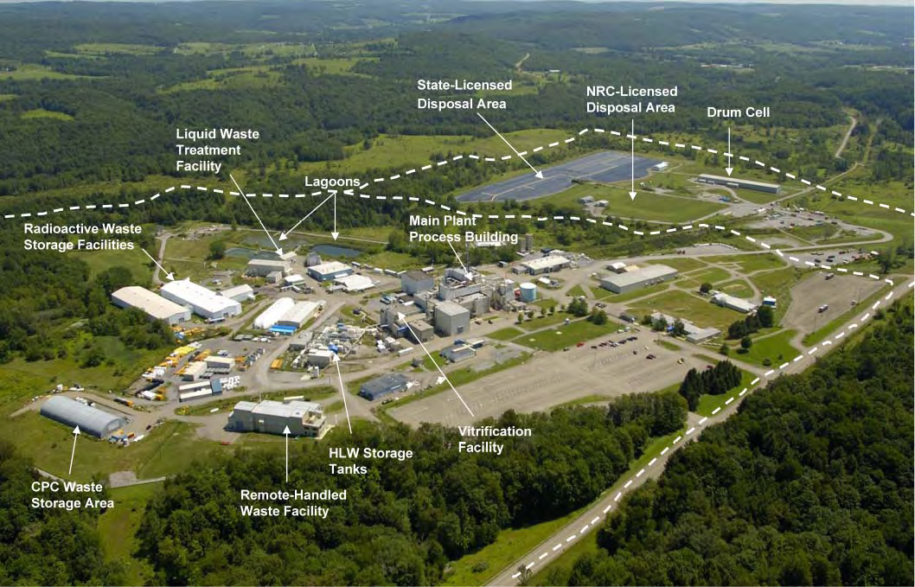
West Valley Nuclear Waste Site
Presentation to Park School
February 27, 2015
Diane D’Arrigo
Nuclear Information and Resource Service
West Valley Action Network

Slide 3
?
Where is West Valley and Why Care?

Slide 4
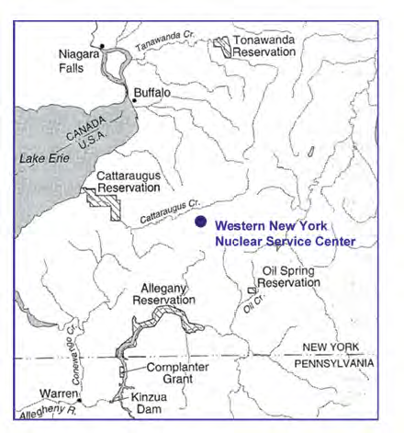
West Valley in relation to
Lake Erie, Buffalo, Niagara Falls, Cattaraugus Creek and the Seneca Nation Territories

Slide 5
West Valley - location
~30-35 Miles south of and upstream of Buffalo
~20 miles upstream of Seneca Nation of Indians SNI Cattaraugus Territory
Cut by streams and creeks that drain into the Cattaraugus Creek which gushes into Lake Erie, upstream of WNY and SNI drinking water intakes

Slide 6
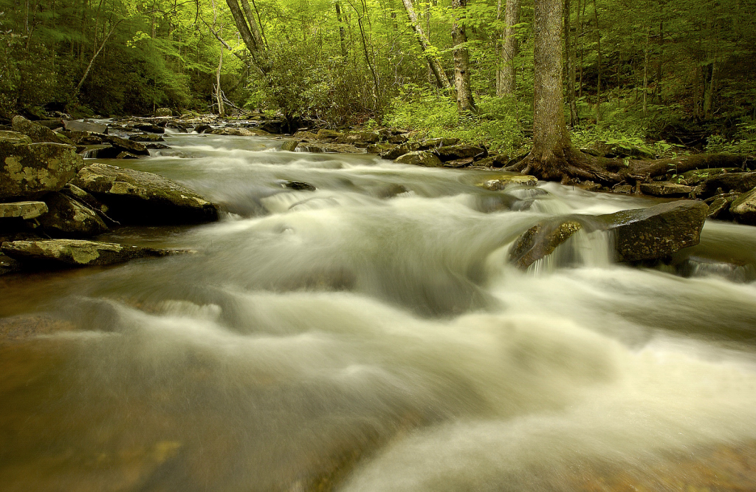
Streams surround and cut through the site—Drain to Cattaraugus Creek , Lake Erie, Buffalo…

Slide 7
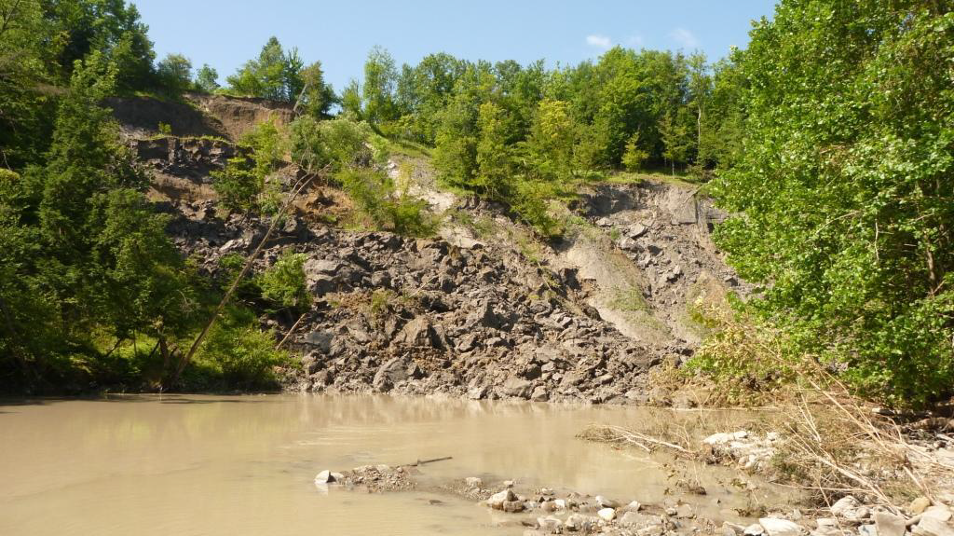
2009 Landslide

Slide 8
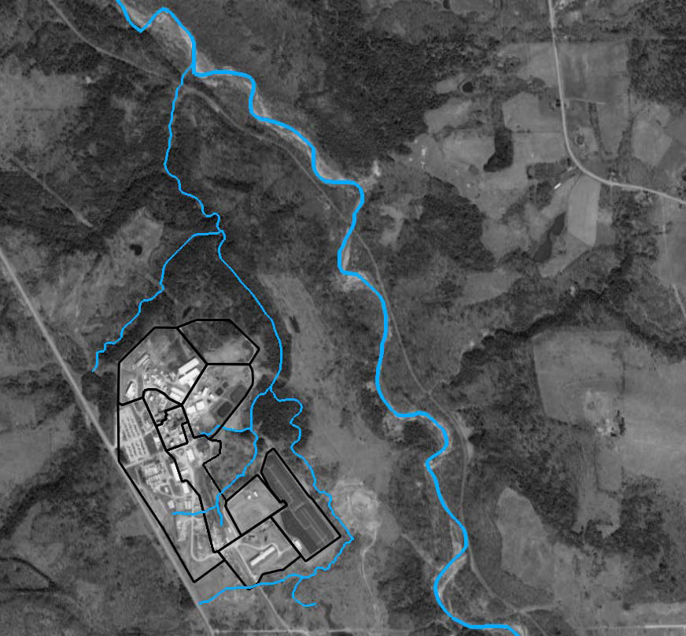

Slide 9
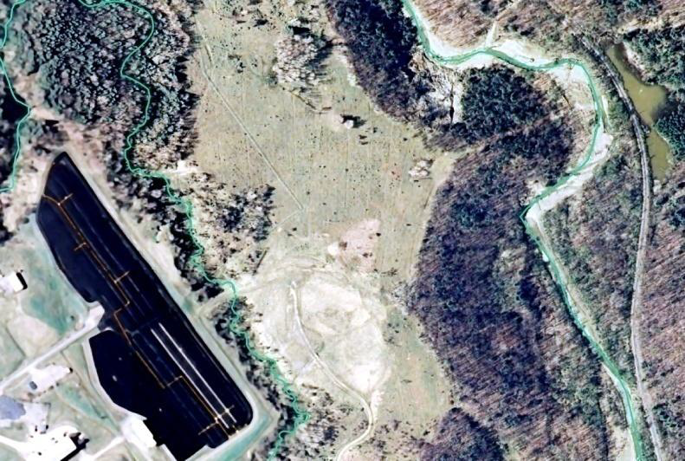
Erosion 2009 flood
1400 feet from landslide to trenches
Buttermilk Creek 15-20 feet closer to nuclear waste

Slide 10
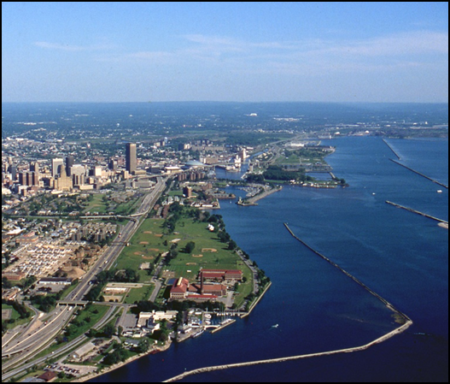
Buffalo Waterfront

Slide 11
Concerns
Glaciers (history and future landscape evolution) scraped the land, leaving a bedrock valley that filled in with many layers. The waste is buried in soil which will eventually erode away taking whatever is buried with them.
Erosion, cracks, sand strata, underground water and radioactive migration in direction of Great Lakes
Radioactivity from waste getting into Streams and Creeks and gushing into Lakes, Rivers, Water Supplies
Where we play, swim, boat, waterski, fish, get our water for drinking, bathing, etc.
Climate change could make this happen faster

Slide 12
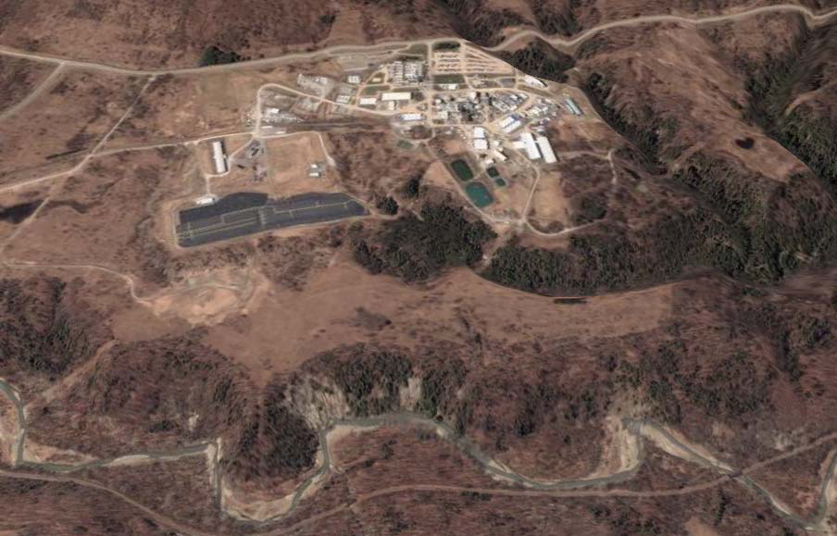
West Valley Nuclear Site on plateaus

Slide 13
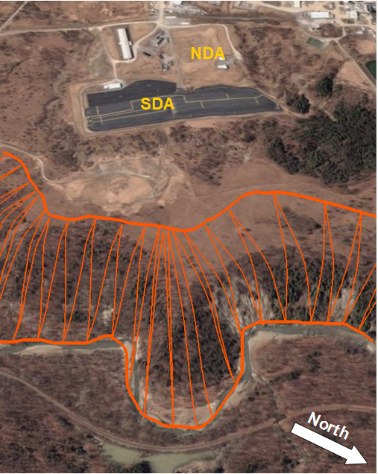
Slope Around
West Valley Nuclear Site Plateaus

Slide 14
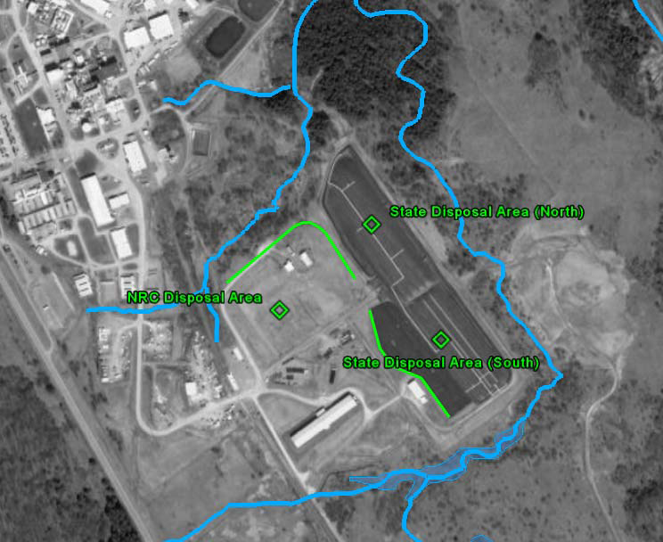

Slide 15
Geological concerns
Erosion
Slumping, Mass Wasting
Water infiltration
Underground and surface water migration
Freeze thaw cracking
Failure to consider Climate Change in projections--CLIMATE CHANGE MAKES IT WORSE!
Both NYS and independent Full Cost Accounting Study researchers (2010) concerned about leaving waste in place in rapidly eroding, stream cut burial areas.

Slide 16
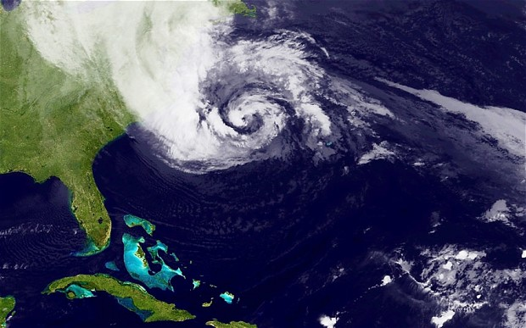
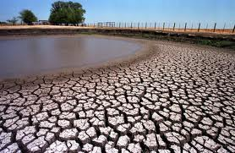
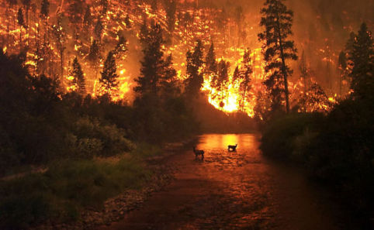
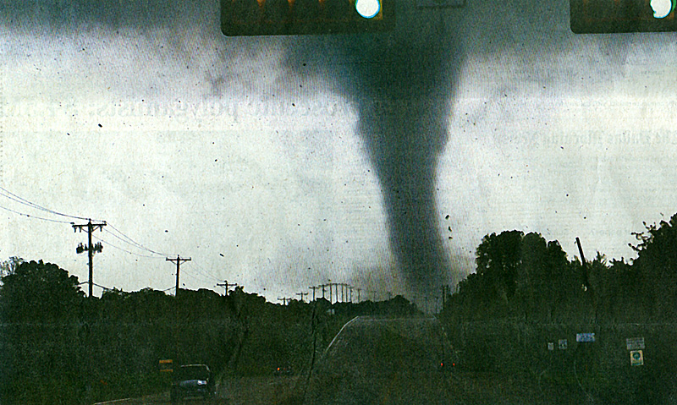
Notes:
Whether or not they’re all climate induced, we’ve experienced many extremely severe and unpredictable storms, droughts, fires, and heat waves in the last decade. These events have resulted in many injuries, crop failures, wildlife disruption, and economic hardships. To some degree severe storms can be expected. However, as many learned from Katrina, though the government and industry may be aware of poor infrastructure and the risk of severe weather events, they are not preparing for the health and safety of all people. Nuclear plants are especially vulnerable. Already an unexpected weather event resulted in the largest nuclear disaster in history.
16

Slide 17
What’s There?
What is Radioactivity?

Slide 18
What’s at the
West Valley Nuclear Waste Site?
Radioactive and Hazardous waste --
Long lasting waste from nuclear power, weapons and research in the 1960’s to 1970’s.
It is in buildings, buried in ditches and holes, huge corroding tanks and leaking through the soil and groundwater.

Slide 19
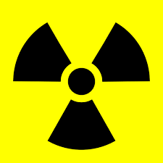
What is Radiation?
Energy that travels in waves.
It includes visible light, ultraviolet light, radio waves and other forms, including particles.
2 basic types: non-ionizing and
ionizing
Non-ionizing radiation can shake or move molecules.
Ionizing radiation has sufficient energy to displace electrons and break molecular bonds, causing unpredictable chemical reactions.

Slide 20
Radioactive Atoms
Unstable– give off particles and energy to become stable
Some do this quickly; Some take millions of years
Each particle or energy wave given off can cause or contribute to causing a cancer
Some occur naturally but some are manmade– like plutonium
Nuclear power fuel when it comes out of the reactor can be some of the most radioactive material in the world – it can kill a person unshielded in just a few minutes
Radioactive Atoms can get into the food chain replacing nonradioactive nutrients and concentrating in our bodies and plant and animal bodies
EX: strontium is taken up like calcium in milk and ice cream will go to bones and teeth

Slide 21
Radiation—NO SAFE DOSE
Cancer –this is the only health effect the government tries to predict
Birth Defects- consider impacts on first 2 generations only
Heart Disease
Reduced Immunity
Genetic Damage
Other health problems in this and future generations
Can’t prevent natural radiation but can prevent manmade

Slide 22
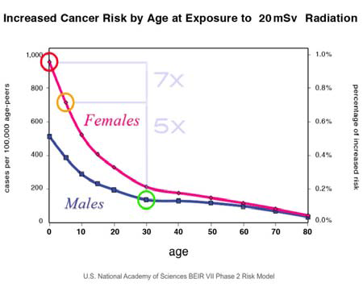
Notes:
The studies analyzed by the BEIR report showed that female bodied people are significantly more affected by radiation, a fact which continues to be stunningly underreported. All female bodied people have a right to know this, please share this information with your friends and family.
It has been long known that children are significantly less resistant to radiation, but it is now understood that female children are 50% less resistant than male children. The reasons for this discrepancy in effects are not scientifically known.
22

Slide 23
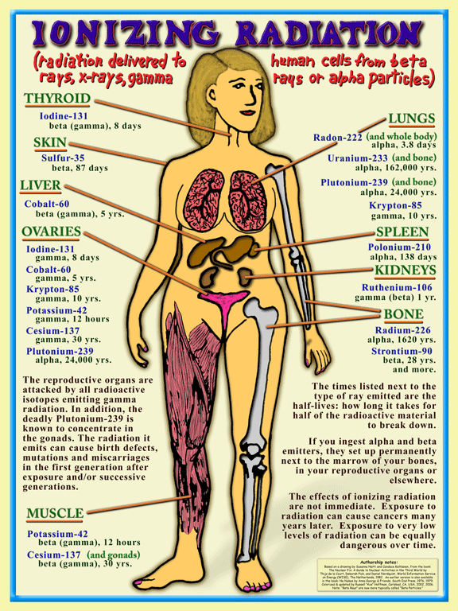

Slide 24
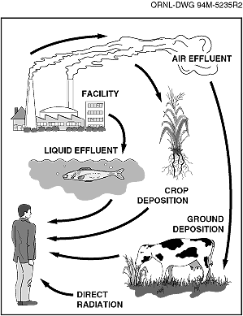
Notes:
Radioactivity moves through the cycles of Nature and Life – reaching us – the picture shows a white middle aged man, which is appropriate since all radiation standards assume a white middle aged healthy man is the one getting the dose, since they were written for bomb-workers and reactor workers
24

Slide 25
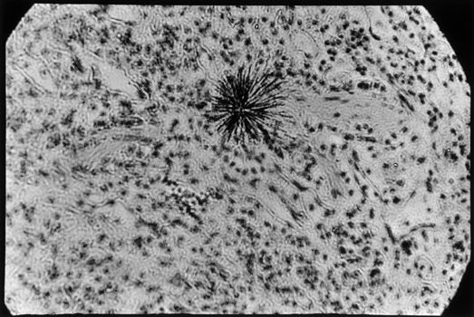
Alpha particles in Lung Tissue
Plutonium
Emits Alpha
From At Work in the Fields of the Bomb, Robert Del Tredici
(Harper & Row, 1987)

Slide 26

Deformities found around nuclear facilities especially TMI (1979), Chernobyl (1986), Fukushima (2011) and as far as California from Chernobyl
Notes:
Heavily deformed scorpion fly found near a nuclear-power plant in Switzerland. ( (Plant Leibstadt (1988). Reuenthal, Switzerland, (Panorpa communis) )
This insect is an example of WHY we are concerned about nuclear energy – radiation hurts our cells. Specifically radiation can damage DNA. Damage to DNA can cause problems in fertility, reproduction, immune system function, and also causes cancer – including fatal cancer.
26

Slide 27
Some Nuclear Waste Lasts for Eons
HALF-LIFE x 10 or 20 = HAZARDOUS LIFE
• Tritium, half-life* of 12 years, hazardous life of 120-240 years
• Strontium-90, half life of 28 years, hazardous life of 280-560 years
• Nickel-59, half life of 76,000 years, hazardous life of 760,000-1,520,000 years
• Iodine-131, half-life of 8 days, hazardous life of 80-160 days
• Iodine-129, half-life of sixteen million years, hazardous life of 160-320 million years
•Plutonium –239 half-life 24,000, hazardous 240,000-480,000 years
* See General Electric Chart of the Nuclides, Twelfth Edition (Revised) 1977, for half lives of radioactive elements.
Notes:
Radioactive elements decay by emitting energy in the form of radioactive particles and rays. As radiation is given off, other elements (some radioactive and some stable) are formed.
The Half-Life is the time it takes for HALF of the radioactive element to decay (give off half of its radioactivity) [6].
Different radioactive elements have different half-lives.
The Hazardous Life of a radioactive element is about 10 or 20 Half-Lives. It is the time it takes for the radioactivity to decay to a thousandth or millionth of its original amount….there is no truly “safe” level. (It is best to measure
the amount of radiation after 10 or 20 half-lives before releasing waste from active controls.)
Reactor waste remains hazardous for a very long time. Most medical waste from treatment and diagnosis is hazardous for a very short time. Research and industrial waste can contain small amounts of some long-lived radioactive materials.
Among the radioactive elements commonly found in nuclear reactor "low-level" waste are:
****
The vast majority of medical waste is hazardous for less than 8 months. Yet, it is in the same category as reactor waste that will be hazardous for hundreds of thousands to millions of
years. Clearly, the definition of "low-level radioactive waste" must be changed. It would make sense to redefine the more concentrated and/or longer-lived waste as high-level. Instead the trend by the US agencies (NRC and DOE) is to try to downgrade some high level waste to so-called “low-level.” Active recontainerization and operational control must be provided for the entire hazardous life of the waste, yet the regulations require only 100 years of passive institutional
control (10 CFR 61.59). Thus, waste hazardous longer than 100 years could be forgotten. Retrievability is essential.
27

Slide 28
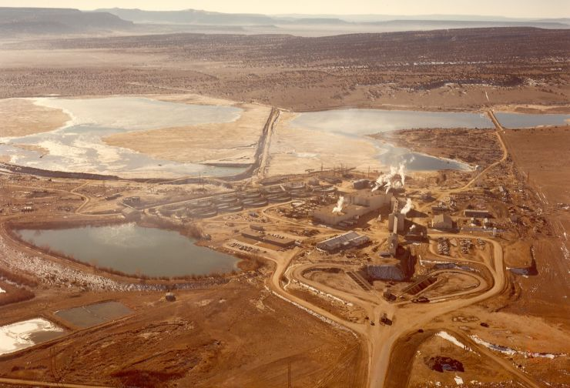
Notes:
Rio Algom Ambrosia Lake mill, New Mexico, USA (1958-1985)
This uranium mill generated more than 33 million TONS of tailings with 18 evaporation ponds.
Tailings contain long lived radioactive metals including thorium 230 and radium 226, with half-lives of 75,000 years and 1600 years.
Uranium mining also consumes huge quantities water, which is often extremely scarce in the places that it occurs. Even after mines and mills are closed, radioactive contamination of the environment will remain.
28

Slide 29
Nuclear Power and Weapons
SHARE THE SAME “FUEL CHAIN” [not “CYCLE”]
Mining Uranium
Milling
Conversion from Solid to Gas
Concentration of Uranium 235 (enrichment) then convert back to solid
Making FUEL pellets/rods/assemblies
Nuclear Power and Weapons reactors
Waste and transport at and between every step

Slide 30
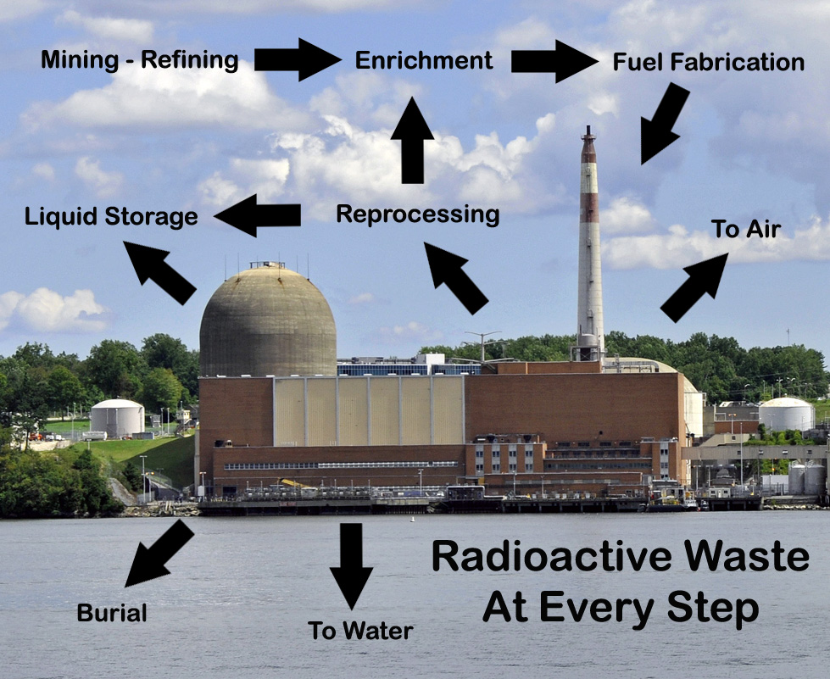
(Milling & Converting)
Notes:
30
It is not possible to operate a nuclear factory without radioactivity coming out – daily! Sometimes batches of concentrated radioactivity are released and yet the local people are not warned – and the owner can average the amount of radioactivity released over 6 months or a year. Many studies report higher incidences of cancer associated with a wide variety of nuclear facilities, ranging from uranium mines and mills to nuclear reactors and reprocessing plants. Reprocessing is where the irradiated fuel rods (waste) that come out of the nuclear reactor after they are no longer useful (millions of times more radioactive than uranium) are chopped up, dissolved in acid and then the plutonium that is inside the waste is separated out. The plutonium is 1% of the waste mass, and the other 99% is still waste, but now liquid and caustic. Lots of what was formerly “high-level” radioactive waste is, by virtue of being smeared all around now considered “low-level” waste. Reprocessing is the biggest mess possible, short of Fukushima.
When enriched uranium is in a gaseous state. At that point it’s converted back to a solid. (They’re pulling out the U238 which is depleated uranium, which goes to conventional ammunition producdtion- shells) They also line personall carriers with it –tanks etc. KY-enrichment facility. Iranians and Iraqis bringing up radiation burns & sickness. Reprocessed uranium has been used in these weapons, coming from reactors and laced with tons of other radioactive particles such as plutonium –Washington Post –joby warrick –broke story

Slide 31
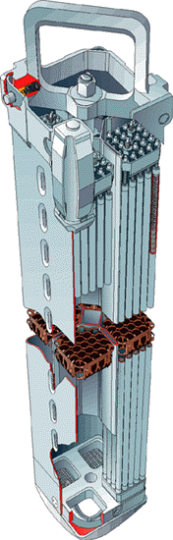
Fuel Assembly
Made of Fuel Rods
Made of Fuel Pellets
Made of Uranium Fuel

Slide 32
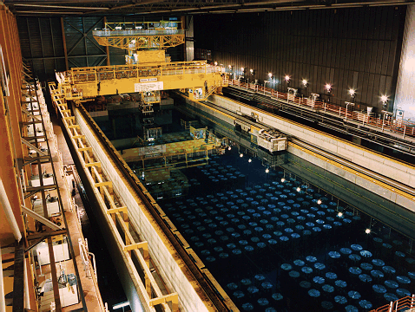
Irradiated Nuclear Fuel
(industry calls it ‘spent’ or ‘used’)
Reprocessed or moved–SOME BURIED in HOLES
More than 10x the radioactive material than the core
Millions of
times ‘hotter’
than ‘fresh’
Uranium fuel
Lethal dose
in minutes
Long lasting
Notes:
Splitting atoms inside the fuel rods inside the reactor core is like a continuous detonation of an atomic weapon – a bomb with the “clutch in” – and so the total radioactivity is very high.
32

Slide 33
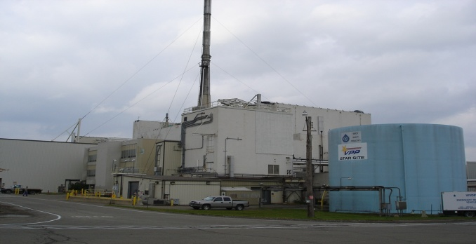
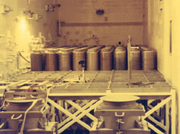
What’s There?
Reprocessing Waste – HIGH LEVEL in danger of reclassification as WIR
REPROCESSING 1966-1972
In 6 years, only reprocessed ~1 years’ worth of irradiated fuel
Highest worker exposures; fires; filter blowout and cesium prong
Hottest radioactive water during reprocessing years
Plutonium behind Springville dam
1960’s spill in building now attributed as cause of large spreading strontium-90 plume
660,000 gallons of High level radioactive waste liquid stored in underground tanks until 1980 law directed Dept of Energy to convert to solid—Now in form of High Level Waste Glass “Logs”

Slide 34
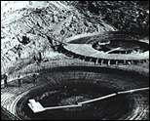
What’s There?
High level waste
Solidification completed 2002
– High level radioactive sludge remains in tanks
– 275 10 foot high “logs” stored in reprocessing building– plans to move to outdoor parking lot by 2020
Dose from “logs” average 2500 rads– highest 7500 rads; 400 rads is a lethal dose (LD50)

Slide 35
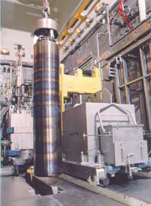
1 of 275 Canisters containing vitrified (solidified in glass) high level waste at West Valley. (Photo from DEC.)
Solidification of the high-level waste (HLW) has been accomplished by a “vitrification” process that was carried out by DOE. This process created a highly radioactive mixture of waste and glass that is contained in 2-foot diameter, 10-footlong metal canisters. There are about 275 of these canisters.
Average surface dose ~2600 R/hr; highest one is 7500 R/hr
Plan is to Store outside near road in casks not a structure.

Slide 36
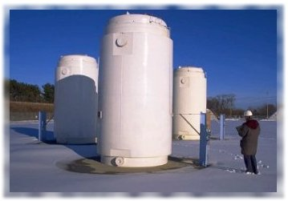
Plans for High level waste in large transport storage casks underway– [different casks at West Valley than shown here]
5
Notes:
There were a number of these dry casks at the Fukushima nuclear plants and they were not affected by the earthquake or tsunami. This is the safest way we have to store nuclear waste at this time.
*********
There is not real time heat and real time radiation monitoring.

Slide 37
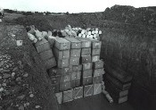
What’s at West Valley Nuclear Waste Site?
Commercial Burial Ground trenches licensed by NY
1963- 1975 Commercial burial of nuclear power, weapons, research waste in 14 unlined soil trenches now believed to contain more than 14 pounds of plutonium (SO CALLED “Low-Level” radioactive waste)
When radioactive trench water filled and burst through the trench caps pouring into creeks and streams that drain into Lake Erie, the burial ground was closed. Recapping helped stop water inflow and outburst.
Originally run by Nuclear Fuel Services, subsidiary of Getty Oil, site is now the liability of NYS, which let Getty go in 1980.

Slide 38
What’s There?
Burial Ground licensed by
US Nuclear Regulatory Commission
50 to 70 feet deep holes with high level waste from reprocessing including damaged irradiated (“spent”) fuel rods from the Hanford N-reactor (weapons reactor)
DOE buried waste from solidification project there when they first came on site 1980
Has required expensive remediation from leaking plutonium (1980s)
Should be part of DOE cleanup but DOE doesn’t agree

Slide 39

What’s there?
Reprocessing/Solidification Building
Lagoons
Above ground stored waste from solidification
Other Structures and Buildings

Slide 40
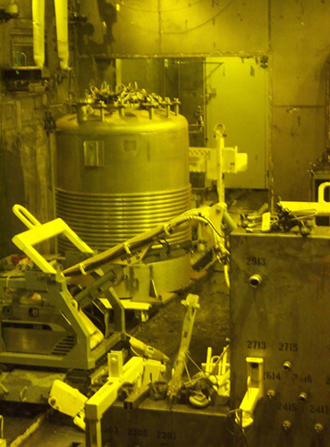
Clean-up by Remote Control
Some waste is so radioactively hot it must be handled by robots remotely behind lead shielded walls or windows.

Slide 41
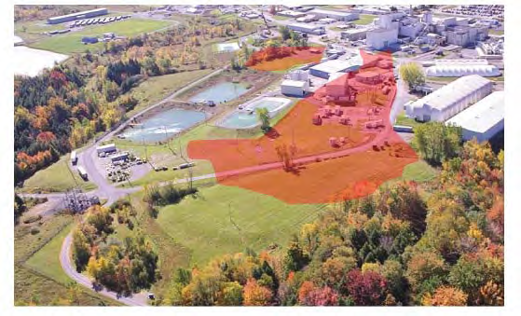
What’s There?
Radioactive Strontium Plume photo as of 2007 underground filtration wall (permeable treatment wall) installed ~2011

Slide 42
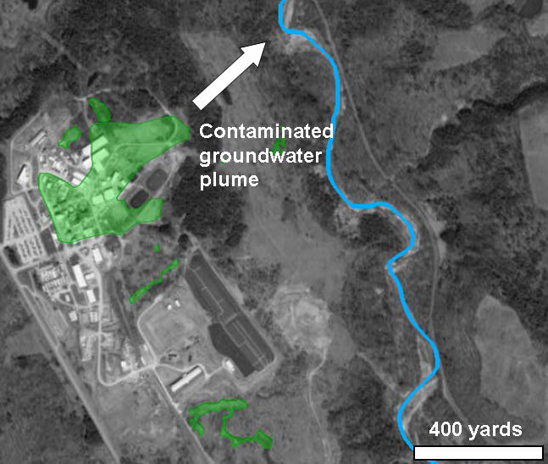

Slide 43
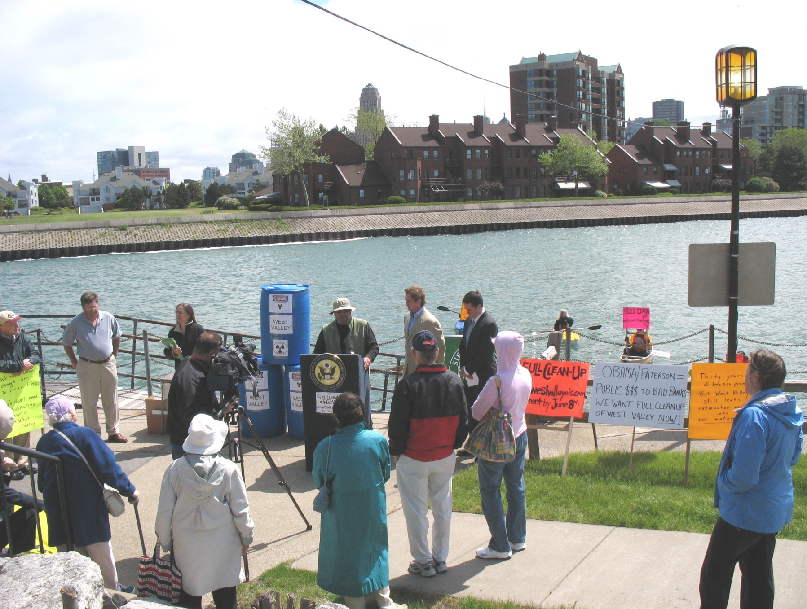
West Valley– Call for Full Clean up unanimous in public comments on 2010 EIS

Slide 44
West Valley Political Concerns
Biased studies, procedures, science teams—NOW A BLACK BOX “PERFORMANCE ASSESSMENT”
Failure to incorporate or value public input and concerns– technical and procedural
Ongoing studies will be used to justify final disposition decision for site in 2020 by Dept of Energy and NYS
State and Federal agencies more concerned with their own conflicts than with overall goal of full cleanup or involving public in meaningful way
Continued Costs to maintain the site
No good place to isolate long lasting waste, but this WILL leak
Federal Policy– Make More Waste – new nuclear reactors and weapons
2020 FINAL DECISION ON IF and HOW TO CLEAN UP WEST VALLEY NUCLEAR WASTE SITE

Slide 45
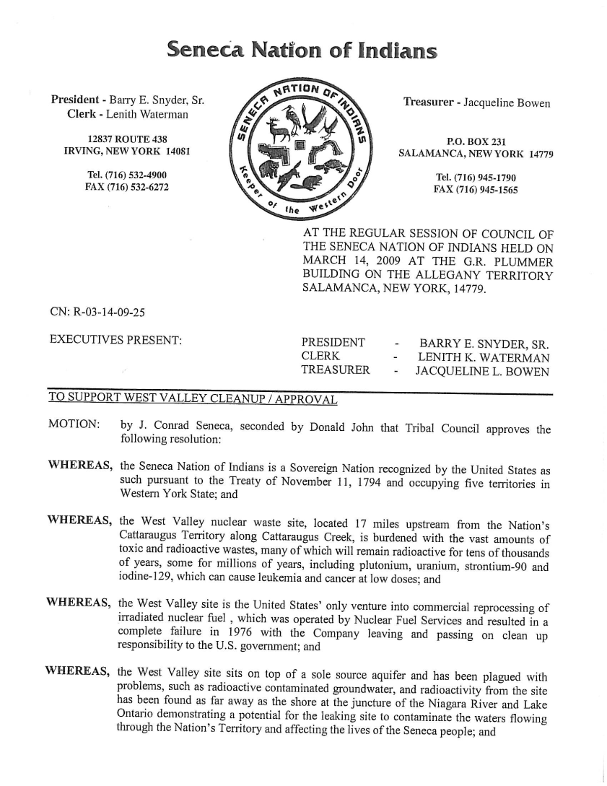
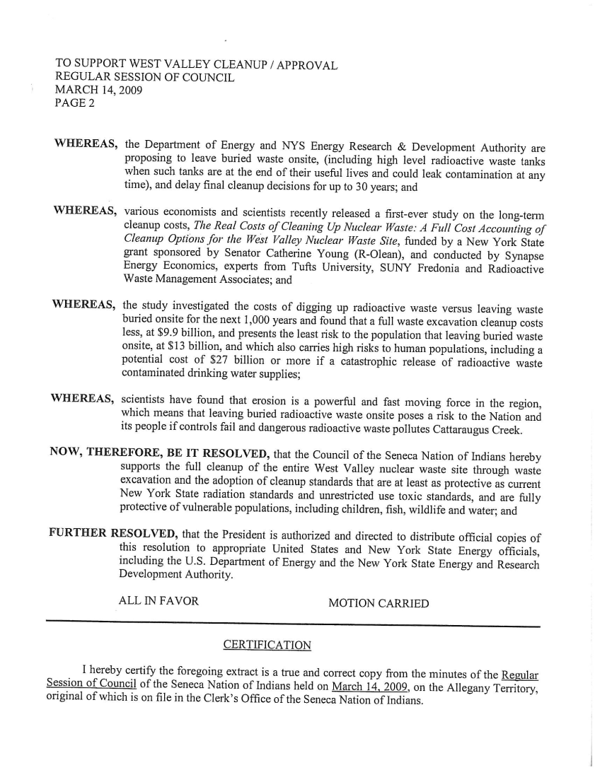
Seneca Nation of Indians Resolution for Full Cleanup of West Valley site
[Same message was also adopted by cities, counties, towns, organizations, state and federal elected officials.]

Slide 46
How Do We Make Sure We Never Forget?
Goal– projects or programs to
  Learn
  Share
  Make Changes
  Clean it up
  Don’t repeat the mistakes

Slide 47
THANKS
Diane D’Arrigo
Radioactive Waste Project Director
Nuclear Information and Resource Service
6930 Carroll Ave Suite 340
Takoma Park MD 20913
301 270 6477 x 15
dianed@nirs.org
www.nirs.org
Part of the WEST VALLEY ACTION NETWORK
www.westvalleyaction.org

