Slide 1
Visions for the grid: A brief survey
Notes:
Not an expert in this topic
Goal is to make you aware of some of the thinking that’s going on throughout the country on how to re-organize/re-form our utility infrastructure to meet the needs of the 21st century

Slide 2
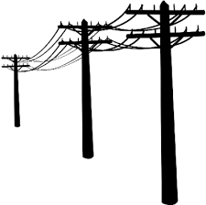
The Grid we have now
source: www.pixgood.com
Old centralized model
Not intended for everyone to participate
Utilities missing incentive to change
Resistant to distributed resources
Notes:
Utilities have very little incentive to consider distributed generators as a potential resource
Centralized production. Long range distribution.
With distributed generation assets like solar, it’s the local distribution system that’s likely to be the hub of the future grid (ILSR)
The American Society of Civil Engineers estimates that utilties will have to spend $20 billion annually over the next several years just to replace aging distribution infrastructure and that “America will see an investment gap in distribution infrastructure of $57 billion by 2020” -- http://www.greentechmedia.com/articles/read/america-gets-a-d-in-energy-infrastructure

Slide 3
ENERGY DEMOCRACY

Slide 4
Principles of the “Utility 2.0”*
(Reliability & Affordability +)
Reduced energy consumption
Reduced carbon emissions
Increased grid efficiency
Increased grid flexibility
* “Beyond Utility 2.0 to Energy Democracy”, John Farrell, Institute for Local Self-Reliance, December 2014
ENERGY DEMOCRACY
Notes:
Reduced energy consumption through efficiency and conservation
Reduced carbon emissions, through a switch from fossil fuels to renewable energy
Increased grid efficiency via a two-­‐way, networked smart grid that uses demand response, local power generation, and other local resources
Increased grid flexibility to integrate large quantities of variable (distributed and utility-scale) renewable energy

Slide 5
What is energy democracy?
“Energy democracy can best be described as an electricity system that empowers the individuals and communities that have the energy resources of the 21st century (e.g. wind & solar) to economically benefit from their use. It shares the principle of Utility 2.0 - an efficient, low-carbon, and flexible electricity system - and adds two more key principles: local control and equitable access”*
* “Beyond Utility 2.0 to Energy Democracy”, John Farrell, Institute for Local Self-Reliance, December 2014
ENERGY DEMOCRACY
Notes:
Local - communities should have authority to make decisions about their energy economy and give weight to economic benefits, not just energy costs. Local ownership of renewables have a higher local economic impact sufficient to outweigh higher production costs
Equitable - everyone has access to ownership and authority over the grid, even if they don’t own property or have substantial wealth.
Participation and benefits to all is enabled in part by:
A networked, transactive energy system
Two-way communication & real-time data

Slide 6
GRID NEUTRALITY

Slide 7
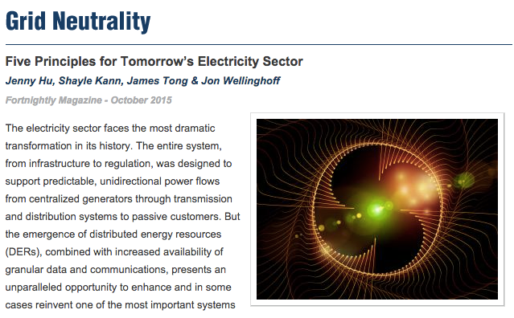
Recent article by Jon Wellinghoff, former chairman of the
Federal Energy Regulatory Commission (FERC)
and several co-authors
GRID NEUTRALITY

Slide 8
Like Net Neutrality
Backbone upon which services are delivered
Level playing field for competition
Fair and open
Taken from www.oecd.org
GRID NEUTRALITY
Notes:
Internet has similar principles upon which decades of innovation, growth and commerce has been built
According to Wikipedia, Net Neutrality is defined as “the principle that Internet service providers and governments should treat all data on the Internet the same, not discriminating or charging differentially by user, content, site, platform, application, type of attached equipment, or mode of communication.”
Grid Neutrality is a similar concept the authors propose to apply to electricity networks as a framework for making decisions
The authors propose five principles to Grid Neutrality:
Empower the consumer while maintaining universal access to safe, reliable electricity at reasonable cost
Demarcate and protect the "commons.”
Align risks and rewards across the industry.
Create a transparent, level playing field.
Foster open access to the grid.

Slide 9
Empower the consumer while maintaining universal access to safe, reliable electricity at reasonable cost
Demarcate and protect the “commons”
Align risks and rewards across the industry
Create a transparent, level playing field
Foster open access to the grid
GRID NEUTRALITY
Notes:
1. “The Consumer Empower Principle”
“Maximize consumers ability to achieve their individual energy needs and the needs of the grid without compromising the universal right of all consumers to access a safe, reliable energy service at reasonable cost.
2. “The Commons Principle”
“Establish clear operational and jurisdictional boundaries for public and private interests”
3. “The Risk/Reward Principle”
Allocate financial risks to stakeholders who are most willing and able to assume them. Safeguard the public interest by containing the risks undertaken by private parties to those participants.
4. “The Transparency Principle”
“Promote and protect open standards, data access and transparency to encourage sustainable innovation on the grid. Prevent any single party – public or private – from abusing its influence.”
5. “The Open Access Principle”
“Allow parties who meet system-wide standards the opportunity to add value to the grid. Apply all standards evenly and prevent any non-merit-based discrimination.”

Slide 10
Thank you!
Corey Ramsden
Program Director, MD SUN
corey@mdsun.org
240-334-7720

