Slide 1
Energy Justice Issues relating to the Grid of the Future
Prepared for
a webinar
Arjun Makhijani, Ph.D.,
President, Institute for Energy and Environmental Research
December 1, 2015
www.ieer.org
arjun@ieer.org

Slide 2
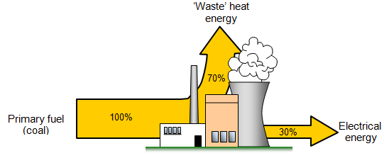
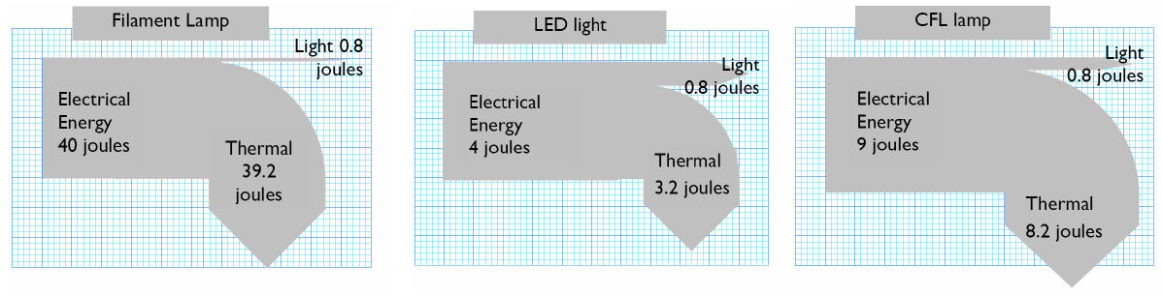
Today’s energy system is wasteful
Example 1: Thermal generation: ~30% efficiency
Example 2: Lighting ~ 2.5% to 20% of electricity to light
Notes:
Sources: https://www.google.com/search?q=coal+fired+generation+sankey+diagram&biw=1366&bih=667&tbm=isch&imgil=atC4EDV9s-ZVWM%253A%253BhLVq9KDBLIFjAM%253Bhttp%25253A%25252F%25252Fwww.bbc.co.uk%25252Fschools%25252Fgcsebitesize%25252Fscience%25252F21c_pre_2011%25252Fenergy%25252Fgeneratingelectricityrev4.shtml&source=iu&pf=m&fir=atC4EDV9s-ZVWM%253A%252ChLVq9KDBLIFjAM%252C_&usg=__g330j4qHoUfxT9EDoXpnyvgK-NU%3D&ved=0CDAQyjdqFQoTCI-A-LDz-8cCFYQqHgodVgAKUw&ei=_Y75Vc-NKITVeNaAqJgF#imgrc=Wohcj0pfReAIuM%3A&usg=__g330j4qHoUfxT9EDoXpnyvgK-NU%3D and https://www.google.com/search?q=sankey+diagram+lighting+LED+CFL&rlz=1C1SKPL_enUS428US493&espv=2&biw=1280&bih=631&tbm=isch&imgil=a3wiUbgC-sUK6M%253A%253B_9XY3WQ8YV0jaM%253Bhttp%25253A%25252F%25252Fwww.myphysics.org.uk%25252Fks4p3hotpot04.htm&source=iu&pf=m&fir=a3wiUbgC-sUK6M%253A%252C_9XY3WQ8YV0jaM%252C_&usg=__SiXR6zljxkLy_T_s8YdJ1ncpO5E%3D&ved=0CCcQyjc&ei=V6doVfzbOIGosQWTg4PYDA#imgrc=W7BJkizBUhht-M%253A%3B_9XY3WQ8YV0jaM%3Bhttp%253A%252F%252Fwww.myphysics.org.uk%252Fsankeylampcomp02.PNG%3Bhttp%253A%252F%252Fwww.myphysics.org.uk%252Fks4p3hotpot04.htm%3B1197%3B306

Slide 3
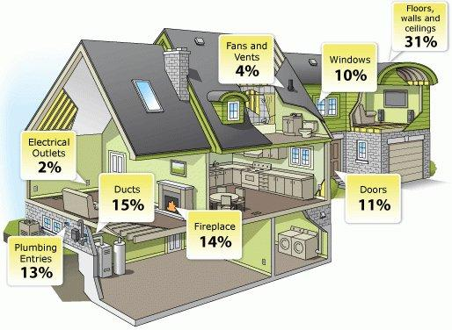
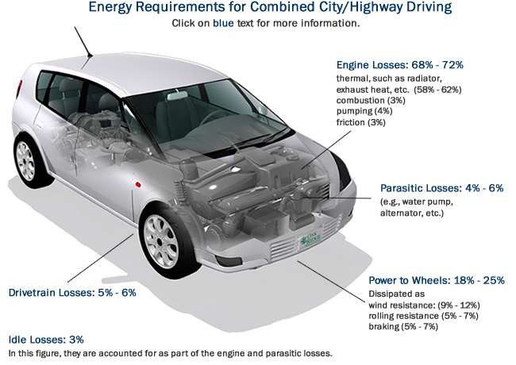
Today’s energy system is wasteful: Slide 2
Example 3: Typical gasoline vehicle ~80 percent waste
Example 4: Leaky buildings
Notes:
Source: https://www.fueleconomy.gov/feg/atv.shtml and https://www.google.com/search?q=home+energy+leaks+diagrams&rlz=1C1SKPL_enUS428US493&espv=2&biw=1280&bih=631&tbm=isch&imgil=94ELqRUVEc758M%253A%253BNB2ebqTMX89QcM%253Bhttp%25253A%25252F%25252Fabqhomeblog.com%25252Fpost%25252F3337370%25252Fis-your-home-energy-efficient&source=iu&pf=m&fir=94ELqRUVEc758M%253A%252CNB2ebqTMX89QcM%252C_&usg=__Ck-SUXEGjorke0I4CfaS9QdZrVg%3D&ved=0CDMQyjc&ei=w6doVYfJIsTJtQW6n4CoAw#imgrc=bCCK9kK8WE39JM%253A%3BV93AJxcLcuDzEM%3Bhttp%253A%252F%252Fwww.totalenergysavers.org%252Fuploads%252FAir-leak-diagram.jpg%3Bhttp%253A%252F%252Fwww.totalenergysavers.org%252F%3B514%3B376

Slide 4



IMPOSSIBE CHOICES: RENT, MEDICINE OR HEAT
HIGH PUBLIC SHELTER COSTS
HIGH HEALTH COSTS
Notes:
Rent/mortgage payments often complete with energy bill payments. Many families lose their homes to evictions and foreclosures as a result. A 2011 survey found that 31 percent skipped a mortgage payment, 14 percent moved in with friends or family, six percent were evicted, and four percent moved into a shelter or were homeless. While four percent reported that they had a mortgage foreclosure in the past five years, three percent reported that they had a foreclosure in the past year.
Once homeless, costs to the families are huge; they are also high for society: costs of shelter ($1,251 to $3,698 per month in D.C.) and the added costs of health care (more than $1,400 per month) are much higher in each month than the average amount of energy assistance is in a year. This does not count the added costs to friends and family of those who move in with them. Chronically homeless people have much shorter life expectancy -- about 30 years less – than average.

Slide 5
Low-income homes are relatively inefficient

Slide 6
Low-income households have not had access to solar energy

Slide 7
WHAT ABOUT ENERGY
ASSISTANCE PROGRAMS?
AID HELPS A LOT
STRUCTURAL PROBLEMS REMAIN + TRANSPORTATION NOT ADDRESSED
Notes:
Current policies in Maryland are to assist low-income families with their heating and electricity bills. In Maryland about 16 percent of households have low enough income to be eligible for assistance; about one-third of the eligible households actually get assistance. There are a variety of reasons for the gap. For instance, ill-health, lack of mobility, and the difficulty of assembling the needed paperwork for completing an application may present significant hurdles in many cases, along with limited aid funds. About 90 percent of those who apply get heating assistance, electricity bill assistance, or both.
There is also a state program for ensuring that the electricity supply of low-income households does not get cut off. It is funded by Maryland electricity ratepayers, supplemented by a portion of the proceeds from the sale of carbon dioxide allowances under the Regional Greenhouse Gas Initiative (RGGI), in which Maryland is a participant. Bill payment assistance helps to significantly reduce energy burdens; however assistance still leaves many families with high energy burdens. For many households burdens remain more than 10 percent of income even after assistance. Six percent or less of gross income is regarded as an affordable energy burden. The survey of high foreclosures and evictions among those who get assistance is strong evidence that serious problems remain even after assistance. Structural change is needed to ensure bills are affordable.

Slide 8
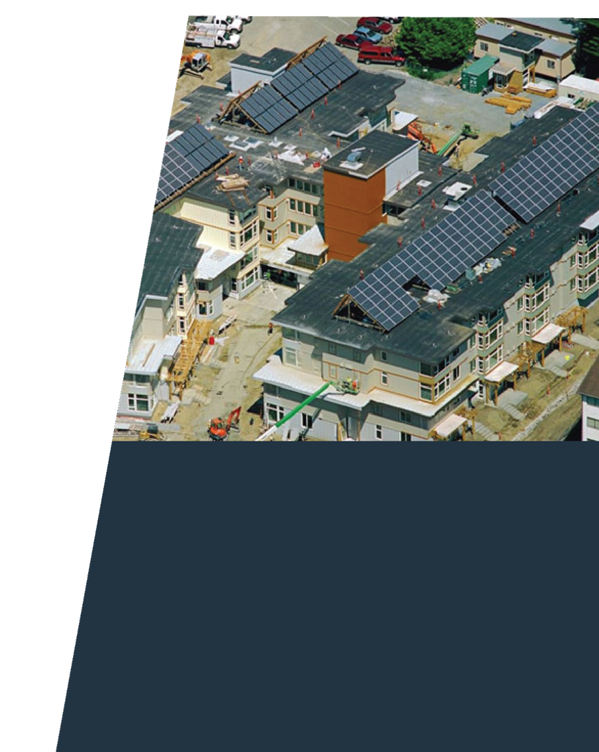
LIMIT BILLS TO 6% OF INCOME + UNIVERSAL SOLAR ACCESS + EFFICIENCY
=
CLIMATE PROTECTION + STRUCTURAL BILL REDUCTION + STRUCTURAL ASSISTANCE COST REDUCTION
Photo: Lake City Village low-income housing, Seattle, Washington.
Photo courtesy of SolarWorld www.solarworld.com
Notes:
Low-income households have generally been excluded from access to solar energy by a variety of barriers. Megawatt-scale distributed solar is now low enough in cost that dedicated procurement would lower the costs of electricity bill assistance, whatever the number of households and whatever the specifics of the program.
The solar electricity cost calculations in the IEER energy justice report assume that the 30% federal investment tax credit will expire at the end of 2016 to be replaced by a 10 percent tax credit for commercial systems, which has no expiry date. The solar program proposed here is NOT a residential rooftop program but a commercial scale solar energy procurement program similar to community choice aggregation, but is specifically directed to low-income households. Rooftop installations would still be available to those who want them and qualify for them.
The cost of the AEP with solar procurement when fully implemented is likely to be less than the current program, for the number of recipients in 2013. By “fully implemented” we mean that essentially all recipients of assistance would sign up for solar supply when they sign up for assistance. The cost of the AEP with solar, even with a much larger number of recipients, may well be comparable to or even lower than the current program if non-energy benefits are taken into account.
Given that solar costs are declining rapidly, there is a strong case for rapid implementation of integrating universal solar access with low-income electric bill payment assistance programs even in the absence of an Affordable Energy Program. If solar is built in the neighborhoods where assistance recipients live, the program could also create jobs locally.

Slide 9
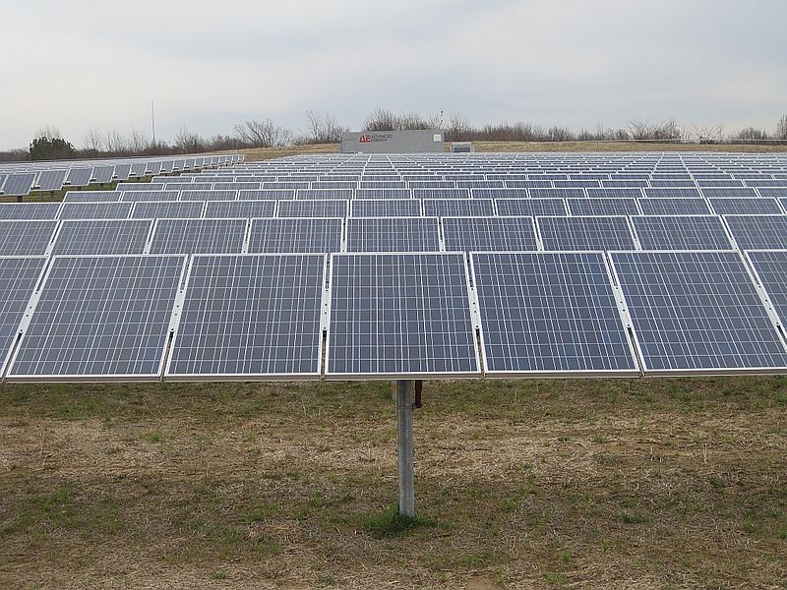
The future grid: some relevant essentials
Variable sources: wind and solar (Maryland and ~>10x as much as needed even with economic growth)
Solar is the main distributed resource
Resilience + low emissions require distributed solar + distributed storage + microgrids + demand response = nested smart grid
Electric vehicles (private and public) and vehicle-to-grid technology

Slide 10
Some Current and smart grid characteristics
 | Current Grid | Smart Grid | Comments
Communications | None or one-way; typically not real-time | Two-way, real-time | Customer needs smart devices and real-time information
Customer interaction | Limited | Extensive
Metering | Electro-mechanical | Digital (enabling real-time pricing and net metering) | Affordable bills will require real time control of consumption and ownership of energy production
Notes:
ABB 2009, p. 3 on the web at https://www02.abb.com/db/db0003/db002698.nsf/0/36cc9a21a024dc02c125761d0050b4fa/$file/Toward_a_smarter_grid_Jul+09.pdf Comments added by Arjun Makhijani

Slide 11
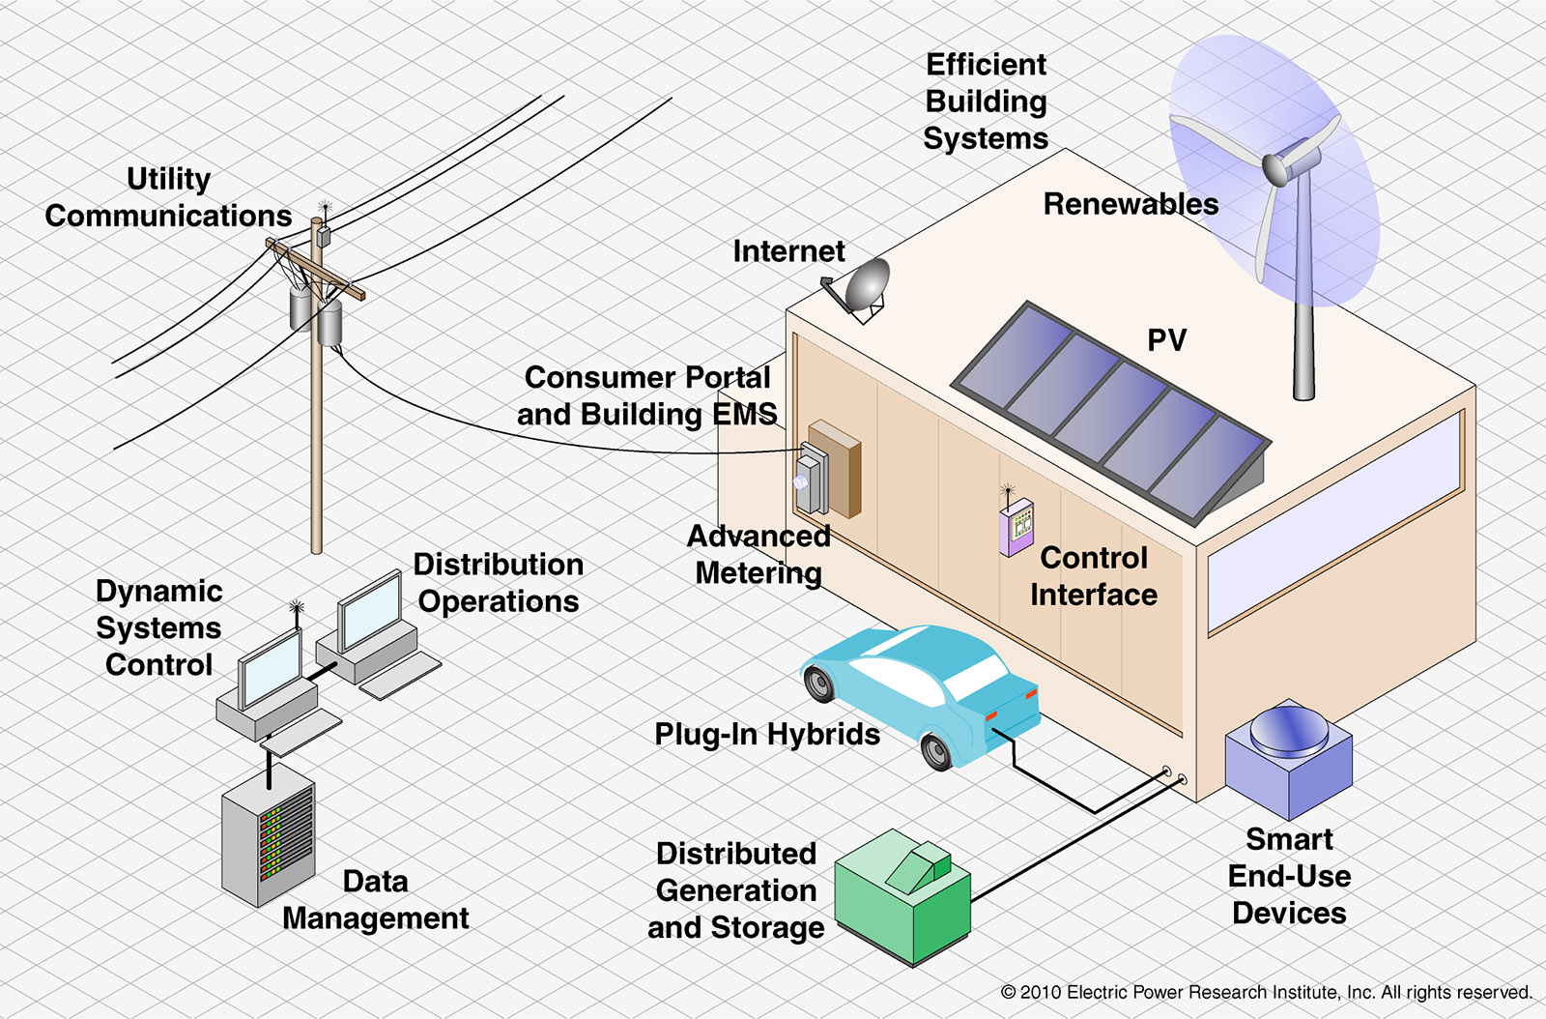
Revenue streams/bill reduction potential
Generate solar energy
Increase efficiency
Participate in demand response
Control consumption to minimize bills
Transition to electric vehicles (low-maintenance and low fuel cost)
Provide services to the grid, including via V2G and local storage ownership

Slide 12
ENERGY JUSTICE AND gOTF
Universal solar access and universal internet access
Once Affordable Energy Program in place, assistance can be in the form of investment: smart appliances + smart devices (tablets, phones, etc.) to optimize bills
Large collateral benefits of internet access – education, work, economic opportunity
Electric vehicles: lower fuel and maintenance cost + V2G revenue potential
Infrastructure in low income areas: Building community solar + electric vehicle charging + distributed stationary storage
Financing: PACE, Green Bank, On-bill financing

Slide 13


AFFORDABLE GRID
FOR ALL
Notes:
This report is part of the Renewable Maryland Project, funded by Town Creek Foundation. Equity is an integral part of the roadmap we are creating to get to emissions-free energy sector by 2050. This work joins anti-poverty, dignity, and protection of nature.

Slide 14
FOR MORE INFORMATION
www.ieer.org
Energy Justice slides based on
http://ieer.org/resource/energy-issues/energy-justice-marylands-residential/
Arjun Makhijani
Institute for Energy and Environmental Research
6935 Laurel Avenue, Suite 201
Takoma Park, Maryland 20912 U.S.A.
301-270-5500

