Slide 1
Update on Yucca Mountain and Transportation Impacts on Native American Communities
Bob Halstead
Office of the Governor
Nevada Agency for Nuclear Projects
March 26, 2015

Slide 2
Overview
What Exists at Yucca Mountain Today
Spent Fuel and High-Level Nuclear Waste Transportation Risks
Impacts on Native American Communities
Recent Developments

Slide 3
What Exists Today at Yucca Mountain
Discussion necessary because of misinformation presented in pro-Yucca Mountain media reports
No waste disposal tunnels
No waste handling facilities
No repository construction authorization
No railroad access
Expired BLM land withdrawal

Slide 4
Only Exploratory Tunnel Exists Cannot be used for storage or disposal

Slide 5
Safety and Environmental Case Against Yucca Mountain
The site is not suitable for development as a geologic repository
The DOE license application is incomplete, inaccurate, and no longer valid
The DOE Yucca Mountain transportation impacts are unacceptable
The DOE environmental impact statement (EIS) does not comply with the National Environmental Policy Act (NEPA)

Slide 6
Transportation Risks
Incident-free exposures to members of the public;
Incident-free exposures to transportation workers;
Release of radioactive material as a result of the maximum reasonably foreseeable transportation accident; &
Release of radioactive material following a successful act of sabotage or terrorism
Source: Halstead and Dilger, ANS IHLRWMC 2011, Albuquerque, NM, April 10-14, 2011, Pp. 410-411.

Slide 7
Spent Fuel Assemblies Are Lethally Radioactive during Transportation
Age (years) | Activity (curies/assembly) | Surface Dose Rate (rem/hr) | Lethal Exposure (time)
1 | 2,500,000 | 234,000 | 7 seconds
5 | 600,000 | 46,800 | 35 seconds
10 | 400,000 | 23,400 | 1.2 minutes
50 | 100,000 | 8,640 | 3.2 minutes
100 | 50,000 | 2,150 | 12.5 minutes
Spent fuel activity and surface dose rates are provided in DOE-NRC, Waste Confidence Proceeding, Statement of Position of the U.S. Department of Energy, DOE/NE-007(April 15, 1980) Table II-4, p.II-56. NRC defines lethal dose as the dose of radiation expected to cause death to 50 percent of an exposed population within 30 days, typically 400 to 450 rem (4 to 5 sieverts) received over a very short time. See http://www.nrc.gov/reading-rm/basic-ref/glossary/lethal-dose-ld.html.
Revised 2.12.2013

Slide 8
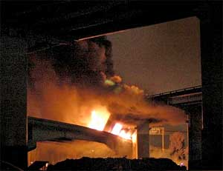
Shipping Cask Vulnerability in Severe Accident Fires is an Ongoing Debate
MacArthur Maze - 2007
Baltimore Rail Tunnel - 2001

Slide 9
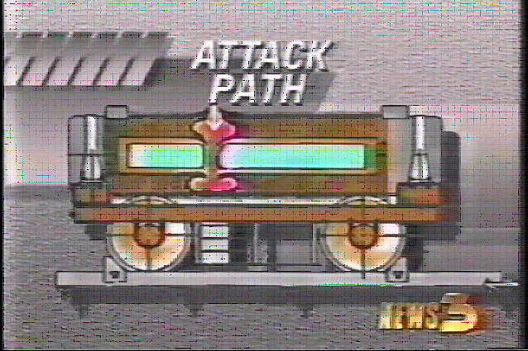
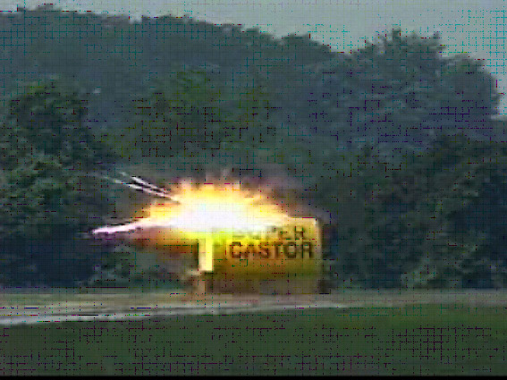
Tests Show Shipping Casks Are Vulnerable to Terrorist Attacks
Truck Cask Test, 1982
Rail Cask Test, 1998

Slide 10
Shipments to Yucca Mountain The DOE proposed Action
Ship 9,495 rail casks (2,800 trains) & 2,650 truck casks over 50 years
If No 2nd Repository: 21,909 rail casks (about 6,700 trains) & 5,025 truck casks
Average 1-3 trains (3-5 casks per train) & 1-2 trucks (1 cask per truck) per week for 50 years
Every day, for 50 years, one or more loaded casks on rail or road, from 76 shipping sites to a single national repository or storage site

Slide 11
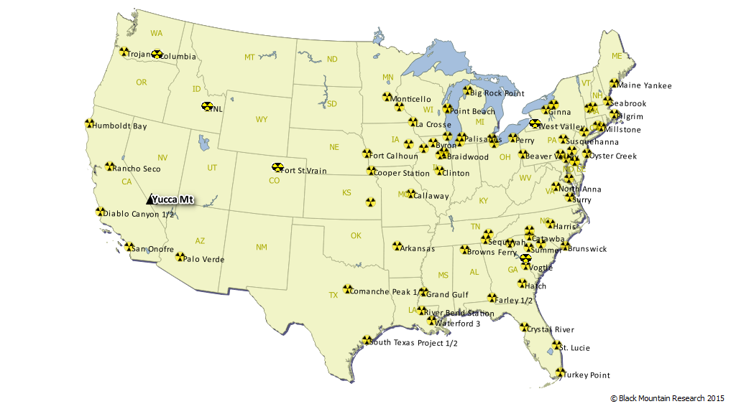
Shipping Sites and Yucca Mt.

Slide 12
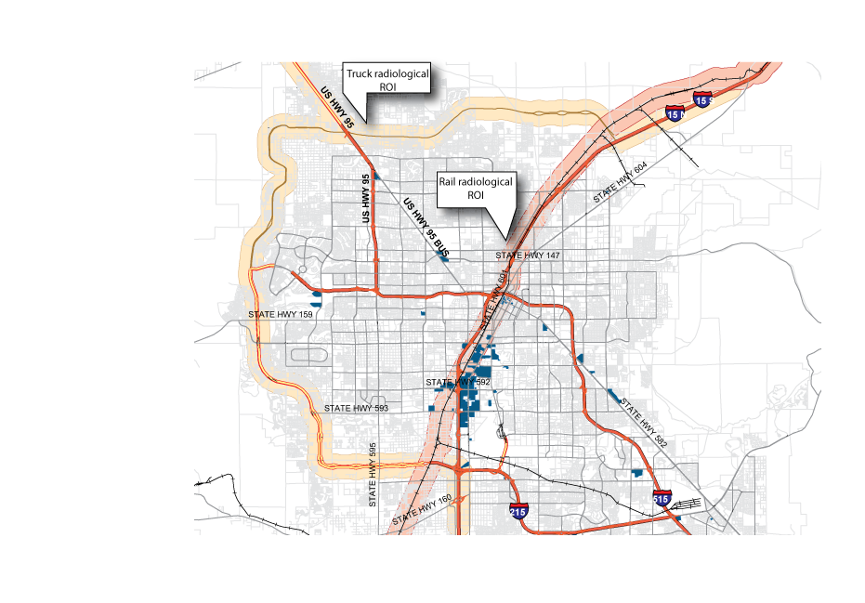
Unacceptable Las Vegas
Transportation Impacts
Rail through Las Vegas
to Yucca Mountain via Caliente
Up to 110 trainloads per year
Located in Las Vegas within 0.5 mile
(800 m) of UPRR Route to Caliente :
34 Hotels, 49,000 Hotel Rooms
40,000 Visitors & Workers
100% of Truck Shipments
1 or 2 trucks per week
220,000 Clark County residents
Live within the 0.5 mile Region
Of influence (ROI) for Truck and Rail

Slide 13
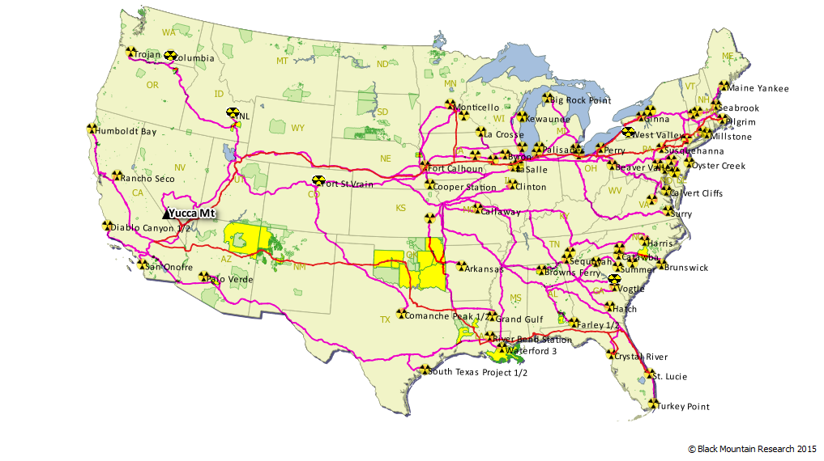
Shipping Sites and Tribal Lands

Slide 14
STATE | NAME | LSADC
Alabama | Cherokees of Southeast Alabama AL | SDAISA
Arizona | Maricopa (Ak-Chin) AZ | Reservation
Arizona | Navajo Nation AZ | Reservation
California | Fort Yuma (Quechan) CA | Reservation
California | Morongo CA | Reservation
California | Round Valley CA | Reservation
California | Agua Caliente CA | Reservation
California | Cabazon CA | Reservation
Idaho | Fort Hall ID | Reservation
Iowa | Sac and Fox (Iowa) IA | Reservation
Louisiana | Four Winds Cherokee LA | SDAISA
Louisiana | Adais Caddo LA | SDAISA
Louisiana | Jena Band of Choctaw LA | TDSA
Louisiana | United Houma Nation LA | TDSA
Minnesota | Prairie Island MN | Indian Community
Nebraska | Omaha NE | Reservation
Nevada | Las Vegas NV | Colony
Nevada | Moapa River NV | Reservation
New Jersey | Ramapough NJ | TDSA
New Mexico | Navajo Nation NM | Reservation
New Mexico | Laguna NM | Pueblo
New Mexico | Acoma NM | Pueblo
New York | Cattaraugus NY | Reservation
North Carolina | Lumbee NC | TDSA
Oklahoma | Cheyenne-Arapaho OK | OTSA
Oklahoma | Caddo-Wichita-Delaware OK | OTSA
Oklahoma | Chickasaw OK | OTSA
Oklahoma | Choctaw OK | OTSA
Oklahoma | Creek OK | OTSA
Oklahoma | Cherokee OK | OTSA
Utah | Paiute of Utah UT | Reservation

Slide 15
Tribes in CA, AZ NV and UT

Slide 16
Nevada Detail

Slide 17
Tribes Detail

Slide 18
Recent Developments
NRC Licensing Proceeding
Congress and Proposed Legislation
DOE Program Developments
Rep. Hardy’s Op-Ed

